Slide 1
No Bullying!
Why? - Where? – What?

Slide 2
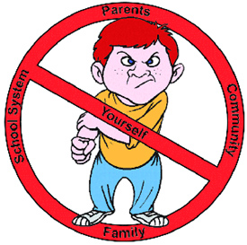

Slide 3
Why do bullies bully?
Bullies bully because:
they are angry.
they are sad.
they don’t like themselves.

Slide 4
Where do bullies bully?
Bullies bully:
on the bus.
on the playground.
in the cafeteria.

Slide 5
What can you do?
You can:
tell them to stop!
tell a friend.
tell a teacher.
tell a parent.

Slide 6
Why do bullies bully?
Bullies are angry.
Bullies are sad.
Bullies don’t like themselves.
Where do bullies bully?
On the bus
On the playground
Where there is no adult
What can you do?
Tell them to stop
Tell a friend
Tell a teacher
Tell a parent

Slide 7
On the Bus
Bully: I don’t like school.
I’m angry
(The bully hits student #3)
Student #3: Stop hitting me!
Bully: No!
(The bully hits student #3)
Student #3: Please help me!
Students #4 & #5: Stop bully. Leave her alone.
Bully: Okay. I’m sorry.
Bus Driver: Honk-honk!
It’s a beautiful day.
Student #1: I like school!
What a good day!
Student #2: I like school too.
I like to read books.
Student #3: I got 100% on my last math test.
Student #4: I like English!
Student #5: I like lunch!

