Slide 1
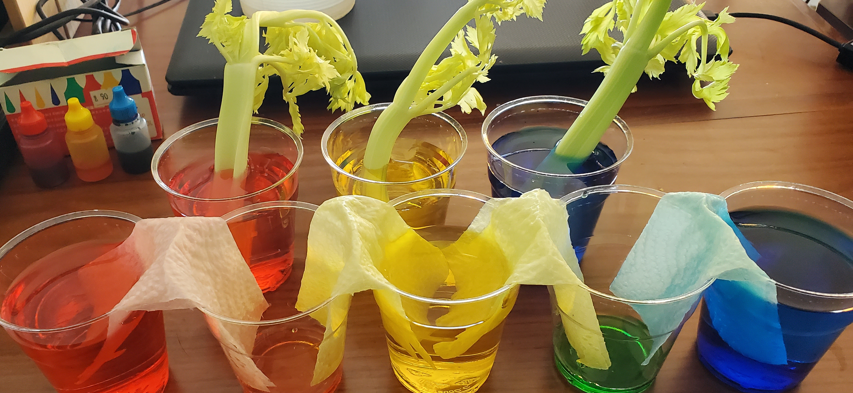
Walking Water

Slide 2
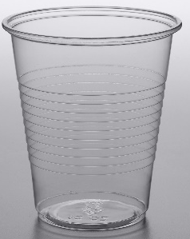
cup

Slide 3
glue

Slide 4
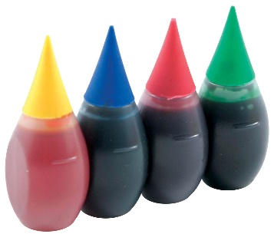
food coloring

Slide 5
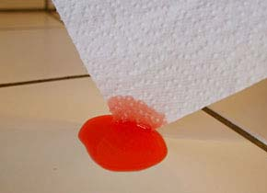
paper towel

Slide 6
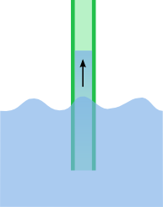
capillary action

Slide 7
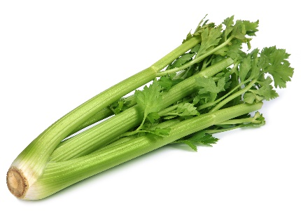
celery

Slide 8
gravity

Slide 9
dish soap

Slide 10
capillary action celery cup dish soap
food coloring glue gravity paper towel
I use a ______________ to drink water. I use ___________________ to clean.
________________________________________ _____________________________________
_____________ causes the apple to fall. I like to eat _____________.
_________________________________________ ____________________________________
_________________________ takes water up to plant leaves.
________________________________________________________________________________

