Slide 1
Science and Colors

Slide 2
We will do 3 Labs
After we learn the vocabulary
1. Walking Water
2. Milk Art
3. Rainbow Lab

Slide 3
Walking Water

Slide 4
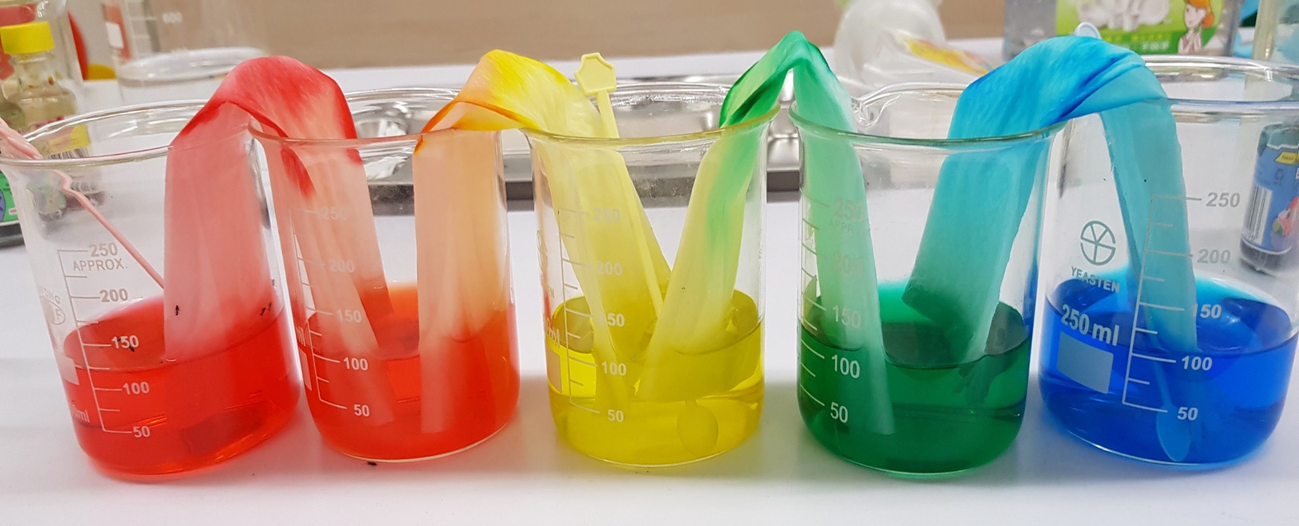

Slide 5
We will learn why this happens.
Capillary action
2. Gravity

Slide 6
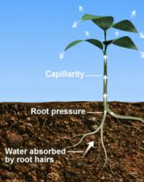
Capillary Action
is how tree roots feed the tree

Slide 7
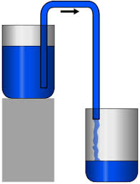
Gravity - The weight
of the water will make it fall.

Slide 8
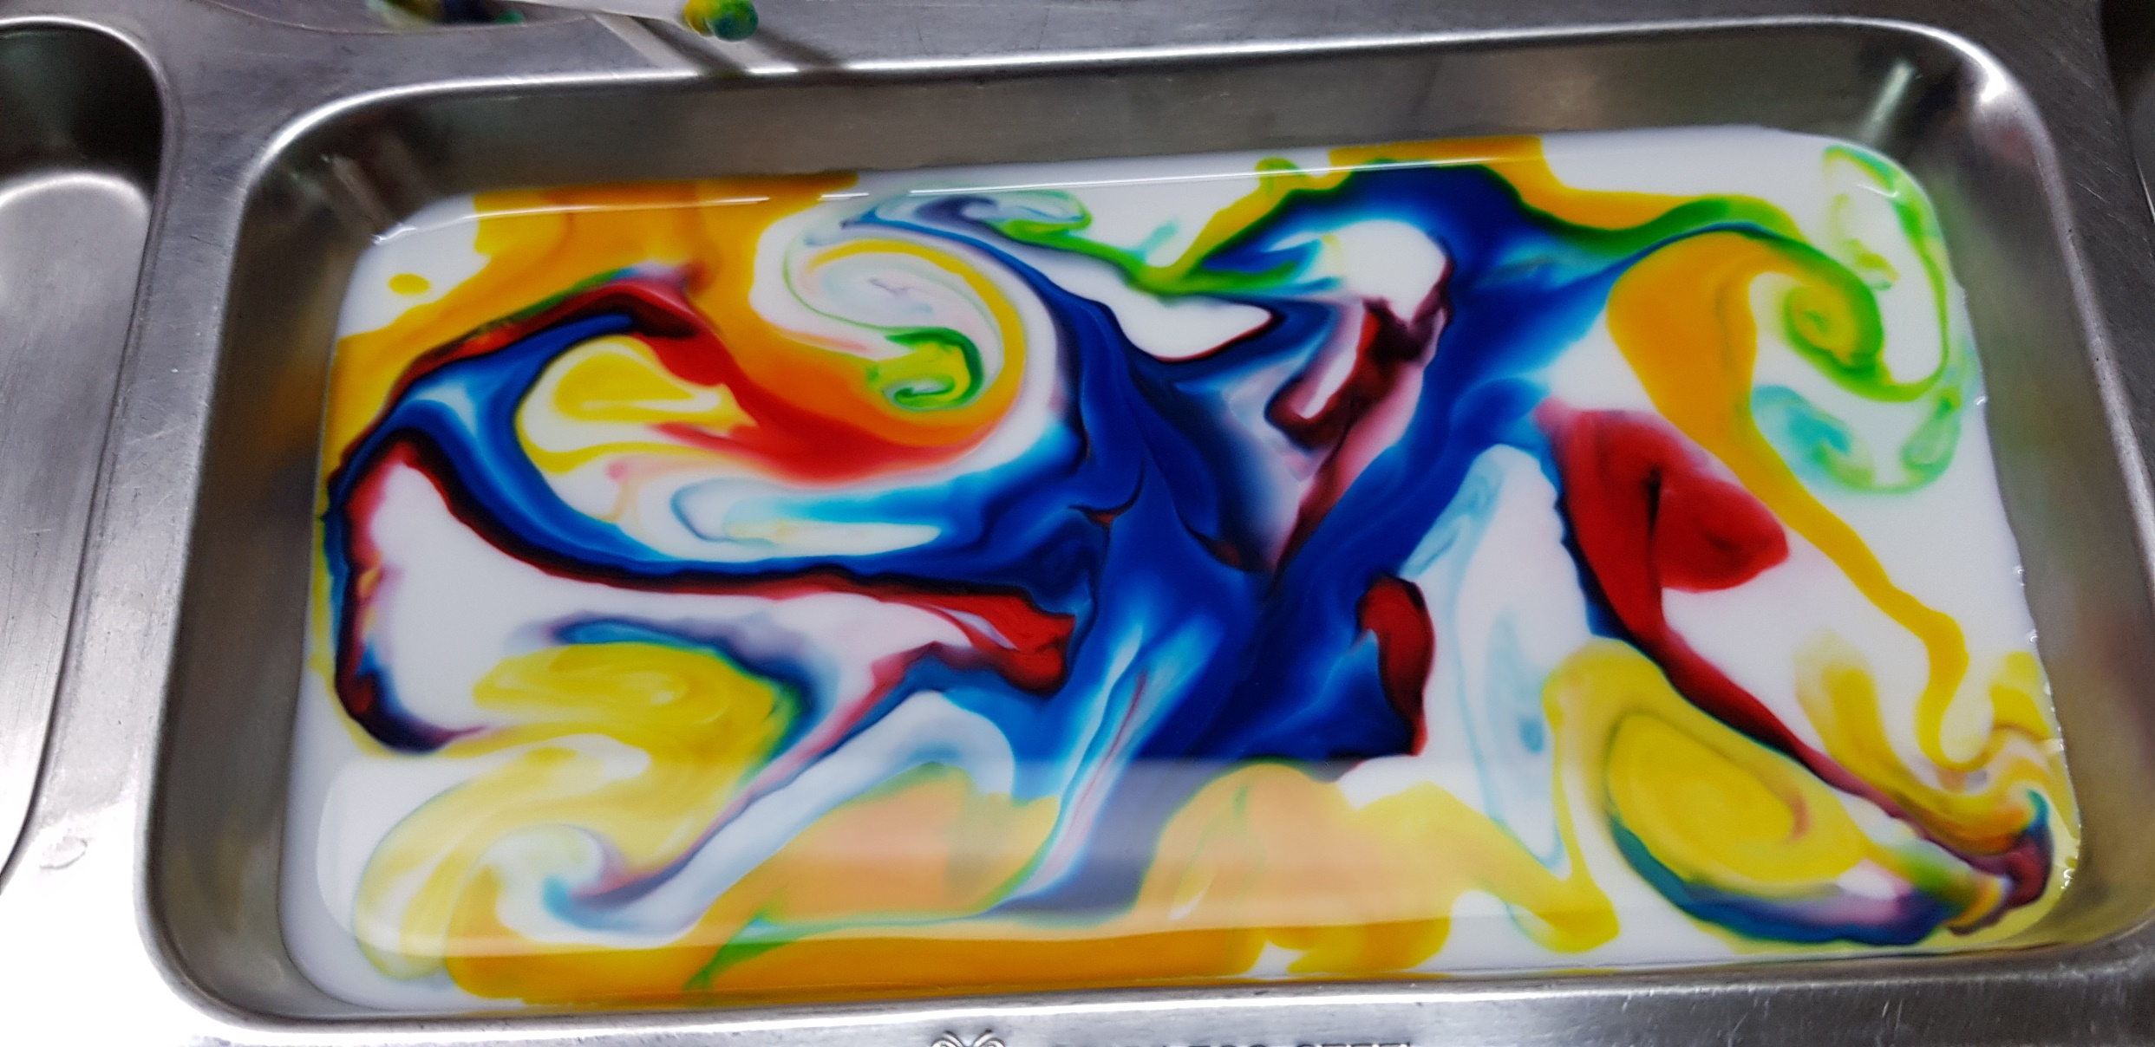
Milk Art

Slide 9
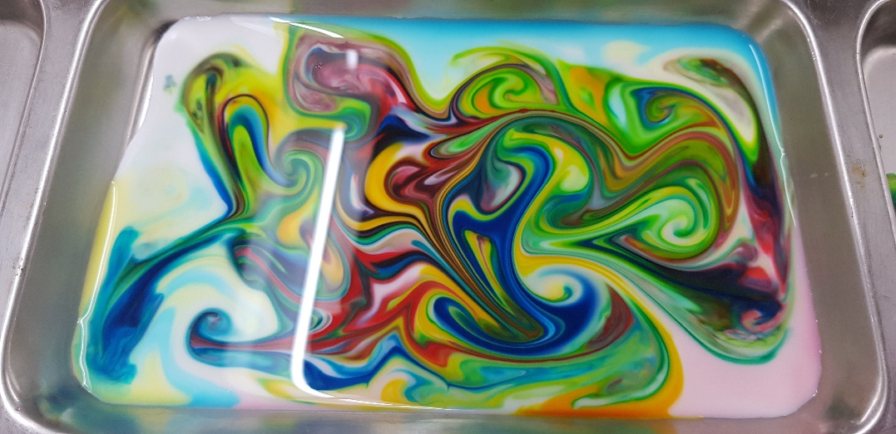

Slide 10
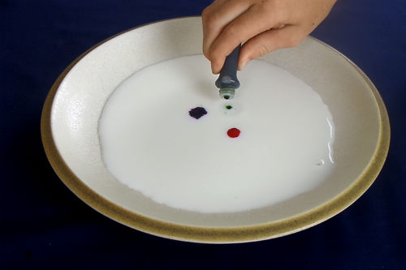
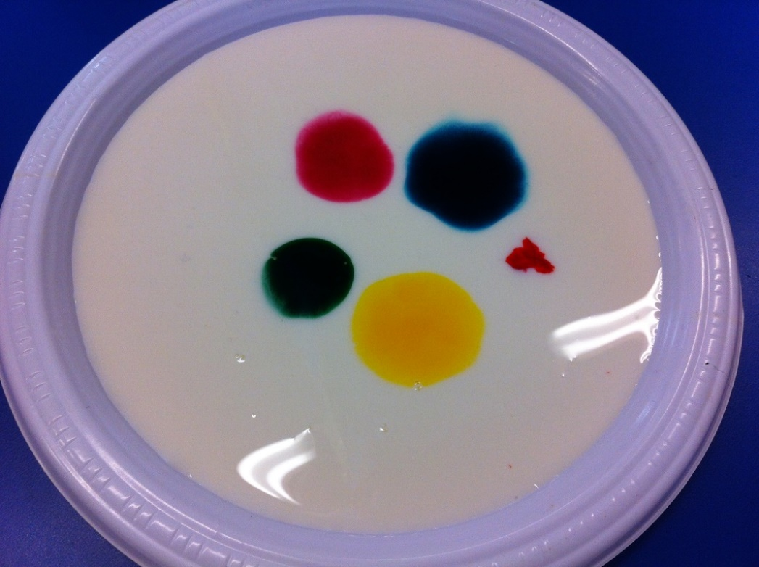
Put a few drops of food color on the milk.
Not too much
You can add more later.

Slide 11
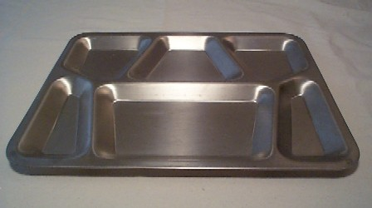
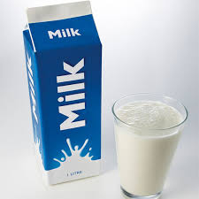
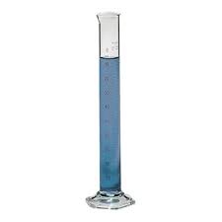
Pour 50 mL of milk onto the tray

Slide 13
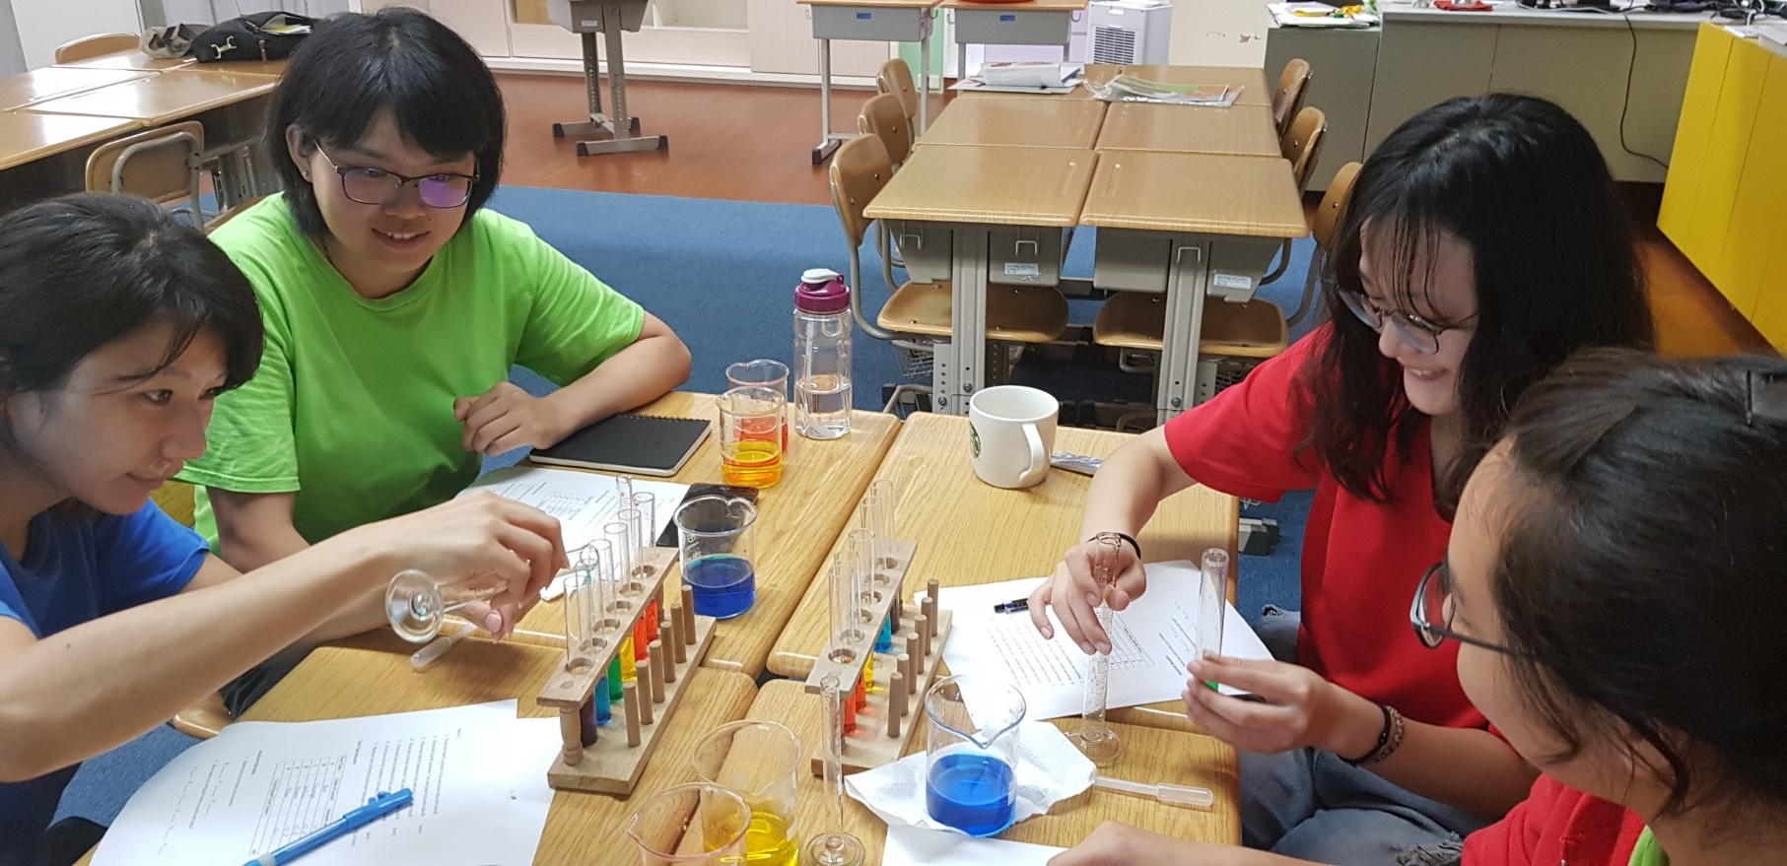
Rainbow Lab
Use science glassware to complete tasks in English

Slide 14
Now let’s learn vocabulary

Slide 15
Graduated Cylinder
Tray

Slide 16
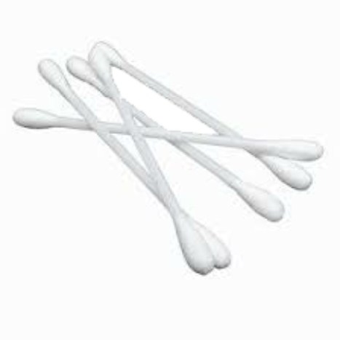
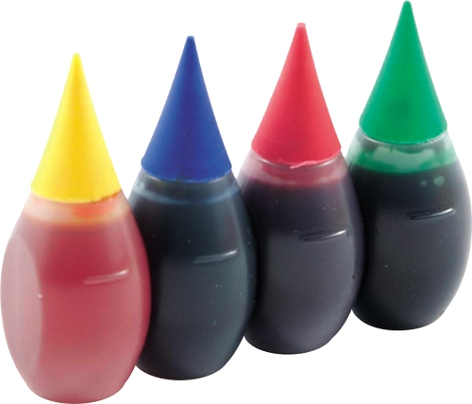
Food Color
Cotton Swabs

Slide 17
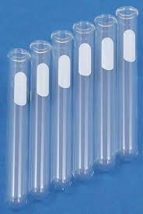
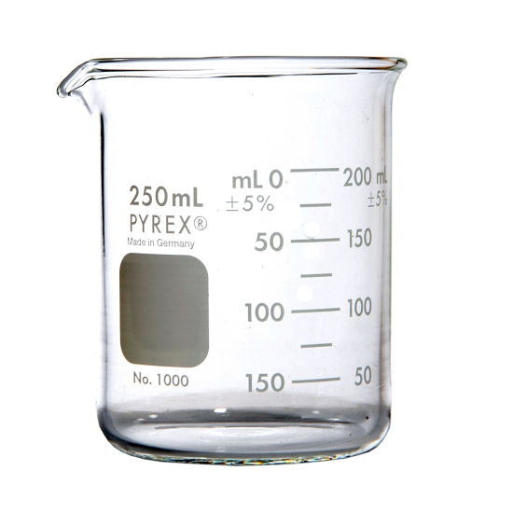
Beaker
Test Tubes

Slide 18
Capillary Action

Slide 19
What causes
the water to drop?
Gravity

Slide 20
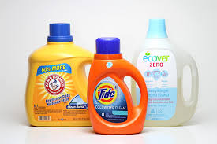
Detergent
Soap

Slide 21
Now Let’s play a game!
Boys vs Girls vs Teacher John

Slide 22
Graduated
Cylinder
Tray

Slide 23
Cotton
Swabs
Milk
Food Color

Slide 24
Detergent

Slide 25
What causes
the water to drop?
Gravity

Slide 26
Capillary Action

Slide 27
Let’s see what you remember.
You may help each other
on the worksheet.

